Slide 1
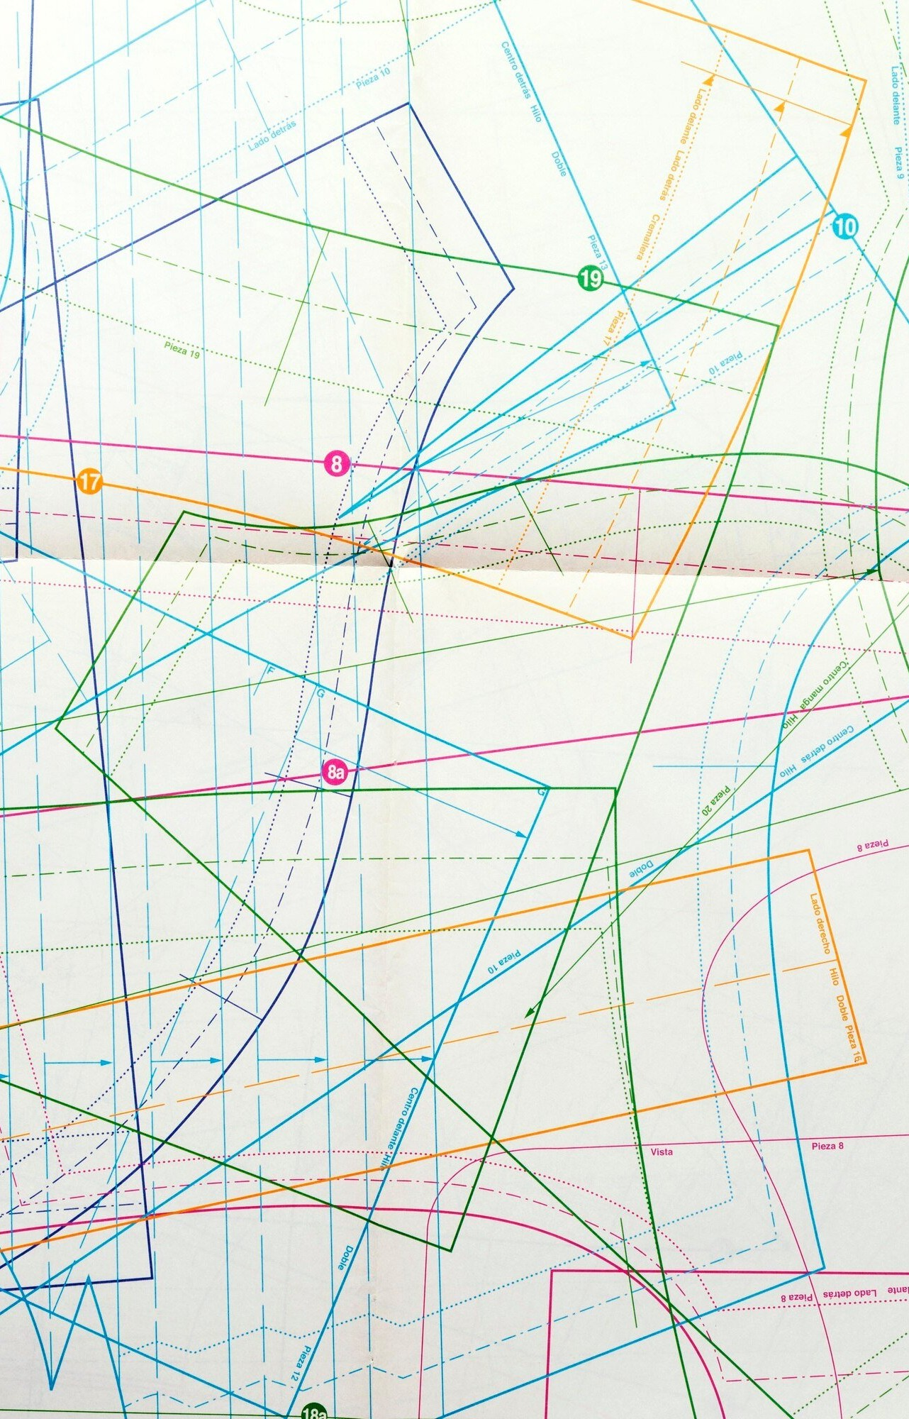
GeoPandas: Leveraging Python's Power for Spatial Analytics

Slide 2

Encient Geospatial Data Analysis
Learn how to use Python’s power for spatial analytics with Geopandas with geo statistical data. Efﬁciently analyze using Python's data manipulation and visualization tools.

Slide 3

What is GeoPandas?
GeoPandas is an open- source Python library that extends the capabilities of Pandas for spatial data. It provides tools for reading, writing, and manipulating geospatial data and integrates with other Python libraries for data analysis and visualization.

Slide 4

Reading Geospatial Data
To read different geospatial data formats such as shapefiles and GeoJson using Geopandas. Use GeoPandas powerful dataframe functionality to manipulate and clean the data for analysis.

Slide 5
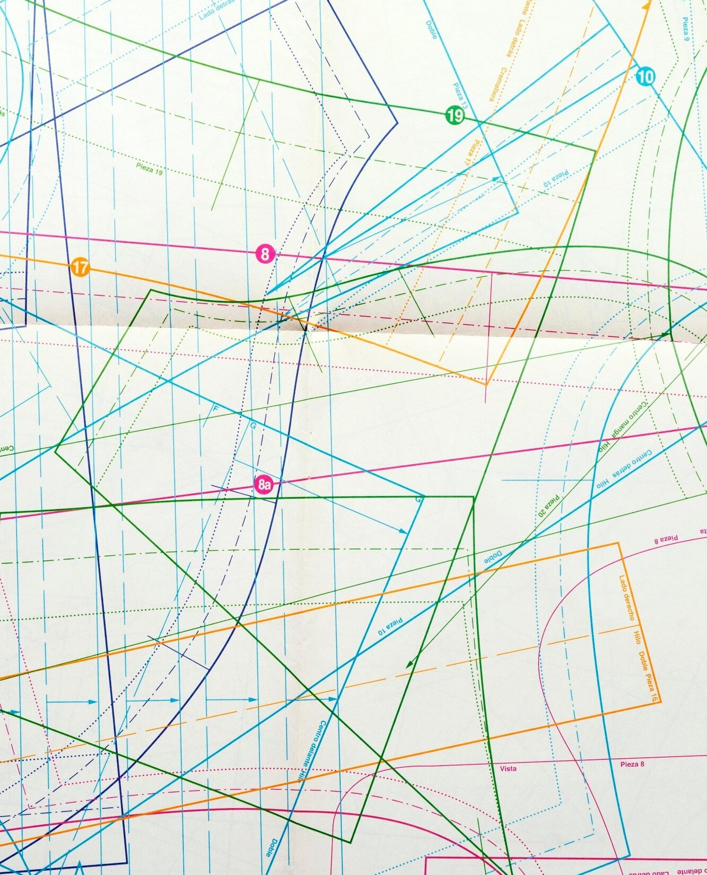
Geospatial Data Visualization
Visualize your geospatial data using Python's Matplotlib and Seaborn libraries. Learn how to create maps and plots that effectively communicate your analysis results.

Slide 6

Spatial Joins
Perform spatial joins to combine different geospatial datasets based on their spatial relationships. Use GeoPandas' overlay function to perform geometric operations such as intersections and unions.

Slide 7




Geometric Operations
Perform geometric operations on your geospatial data using GeoPandas. Learn how to calculate area, length, and other geometric properties of your
data.

Slide 8
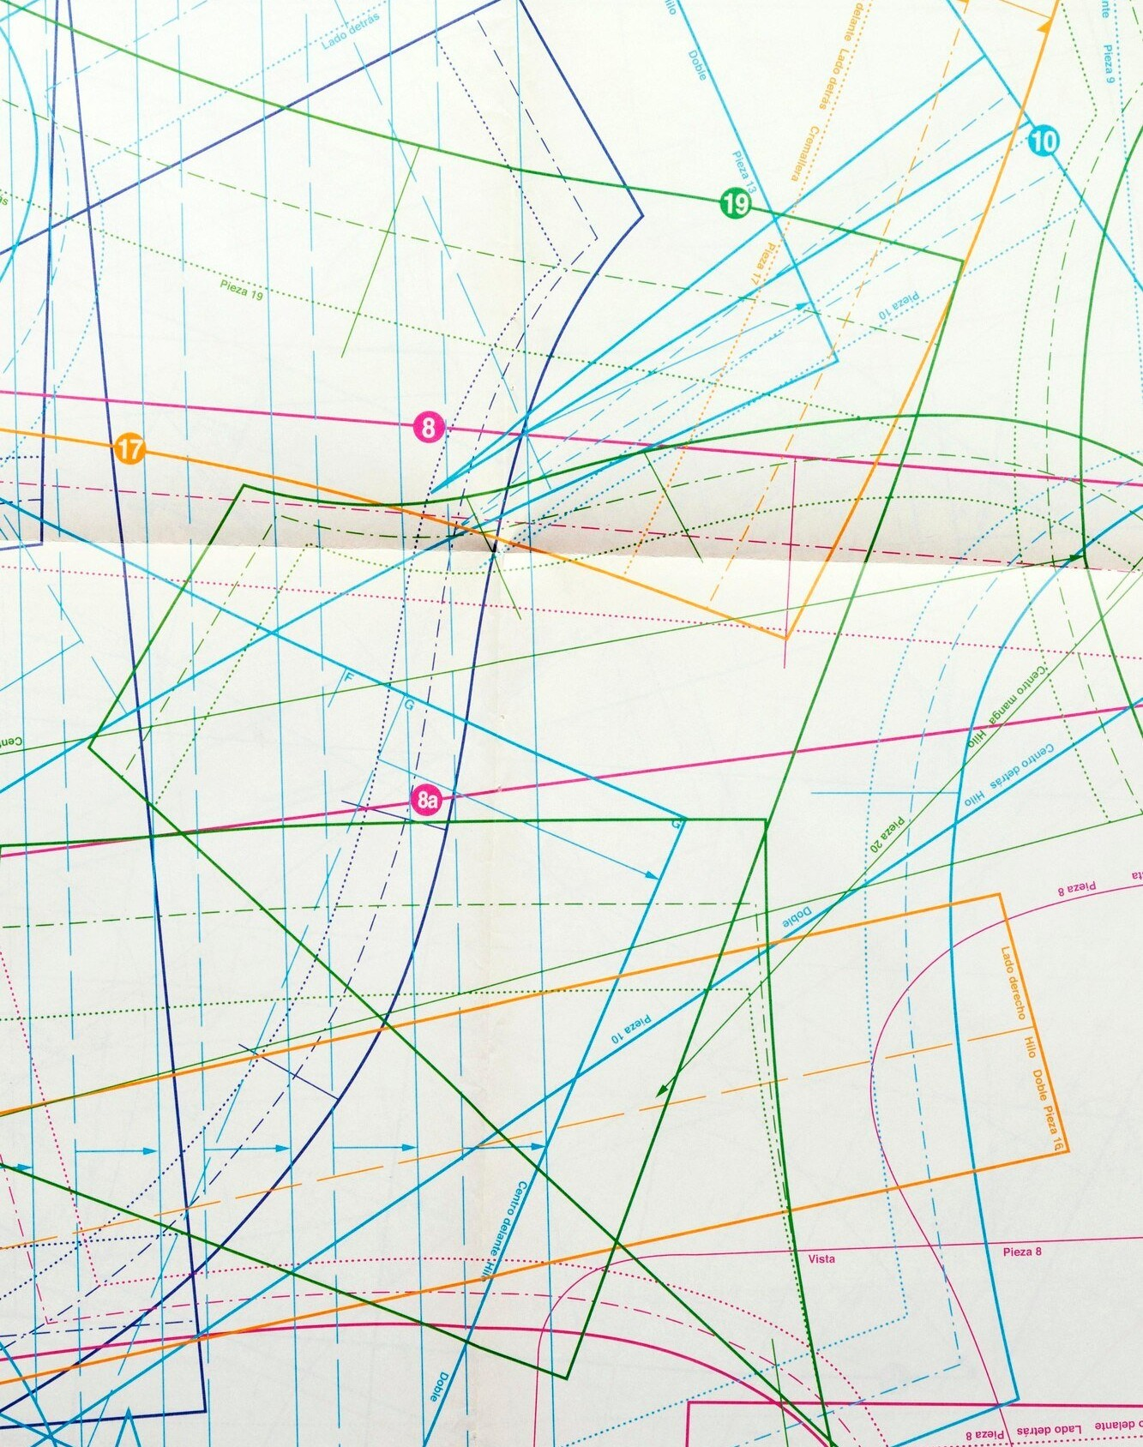
Spatial Analysis
Perform spatial analysis on your geospatial data using Python's geoprocessing libraries. Learn how to calculate distance, buffer zones, and other spatial statistics.

Slide 9

Python Libraries Integration
To integrate GeoPandas with other Python libraries such as Pandas, NumPy, and Scikit-learn. Use the power of Python's data science ecosystem for your spatial analysis.

Slide 10
Conclusion
GeoPandas is a powerful tool for geospatial data analysis that uses Python's data manipulation and visualization capabilities. With GeoPandas, you can efﬁciently analyze geospatial data and solve complex spatial problems. Start using GeoPandas today and take your spatial analysis to the next level.

